Slide 1
Unlocking the Value of Equipment System Data
Introduction to Project Haystack and Data Modeling for Equipment systems
John Petze
executive director, Project haystack
CO-Founder, SkyFoundry

Slide 2

Our Goal – Making Data from Diverse Systems Easy to Work with

Slide 3
The Challenge
Most data produced by devices and equipment has poor descriptive information to define what the data means
There has not been a standardized approach to adding semantic data (meta-data) to device data
Names can’t do the job
Manual, labor intensive processes are required to add semantic definitions to data before analysis, presentation and other value creation can begin
This forms a barrier to the effective and efficient use of device data – adds cost and slows the use of data

Slide 4
Project Haystack Is…
A community of people working to address the need for a standard “semantic modeling” method for device data
Open source – no cost to use
Worldwide community
Proven and deployed in thousands of facilities

Slide 5
Project Haystack Provides…
A standardized methodology for describing data that makes it easier and more cost effective to analyze, visualize, and derive value from our operational data
Think of it as a “MARKUP LANGUAGE” for data

Slide 6
The Challenge – A Use Case
Analyze this: zn3-wwfl4 = 76.2
Hmmmm… What does the number represent? Deg C, F, KW, kPa???
Need to know units. Lets say it is Deg F
Hmmmm… Is 76.2 Deg F OK?
What is it? Zone temp, Return air temp, chilled water temp? Lets say it’s a Zone
What is the schedule for the space? Schedule #1 = 7:30 AM - 6:30 PM
What AHU is it served by? AHU-1
What VAV box serves it? VAV-27
How can I convey these answers in a standard way that other software can interpret?

Slide 7
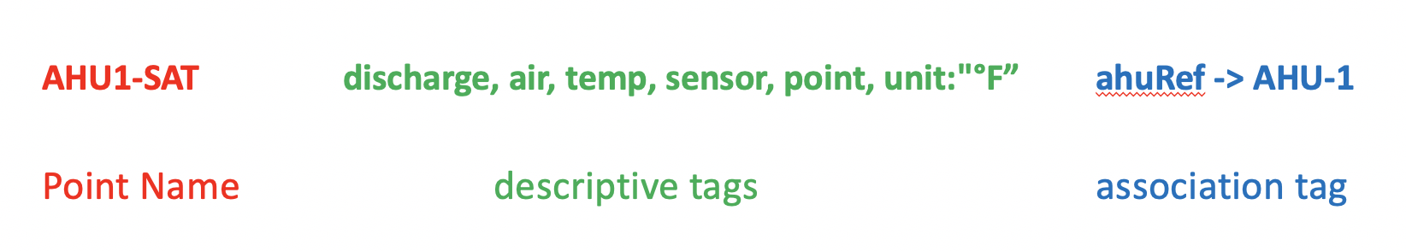
A Use Case

Slide 8
Analogy: A Markup Language
for Device Data
Why can I point my browser at your website and read what you have published?
We didn’t pre-arrange for me to be able to interpret your website code
It works because industry agreed on a mark up language (HTML)
If you use HTML I can read the “data” on your website (text)
Haystack does the same thing for device data

Slide 9
But Haystack Is More Than One Thing…
First – a standard methodology for defining and representing device meta data (descriptive data) – a specification on how to do it
Second – Standard vocabulary (tag sets), taxonomies (equipment models) developed by consensus of the community
Third - Software Tools
  REST API to easily exchange Haystack tagged data among applications
  Reference implementations: Java, node.js, Dart, Python, C++ others
  Plug-ins to enable various systems to “speak” haystack.
  Tools to streamline the tagging process
Fourth – The ongoing effort by Working Groups to develop tagging models, extend the standard, work with other standards groups, and educate the market

Slide 10
The Payoff – What It Enables
Applications that just work !
Example: Equipment Graphics that auto-generate just by reading the meta data associated with points
Control logic can ”find” all similar devices it should be applied to (think of room controls or VAV’s)
Easier integration among software applications – Apps can understand and consume data without human interaction to “map” data
A new generation of engineering tools to streamline project implementation tasks

Slide 11
Why Haystack Matters
We want to easily utilize data from various sources for reporting, visualization, analysis, supervisory control, and decision making
Lack of standardized naming conventions and adequate semantic information in control and equipment systems makes this a labor intensive effort
Names on their own can’t solve the challenge – too much information to be carried in a name, no standardization, and they already exist the way they are – your not going to change all existing names!
This is a major barrier to utilizing the rapidly growing amount of data produced by smart systems

Slide 12
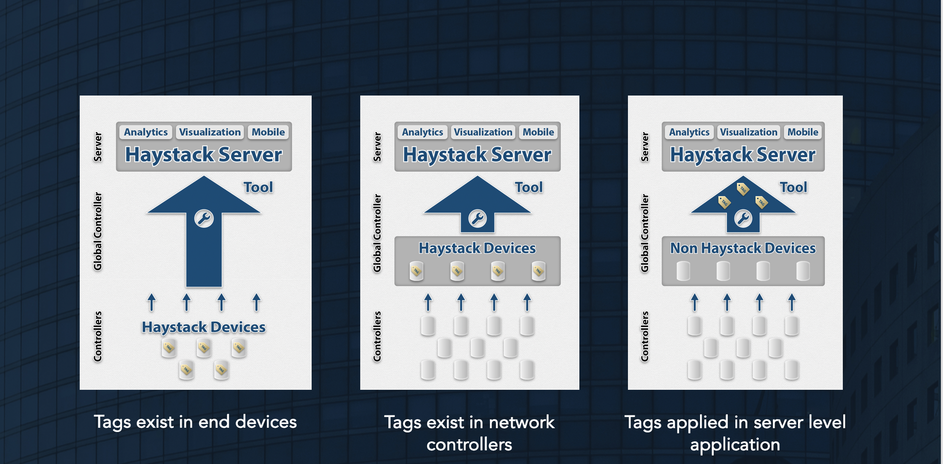
Architectures Using Haystack

Slide 13
Haystack – Adoption and Support
Winner of 2013 Digie Award for Best Intelligent Building Technology Innovation
http://project-haystack.org/forum/topic/100
Biennial Community-Produced Haystack Connect Conferences: 2013, 2015, 2017, 2019
http://haystackconnect.org/
Press Announcement Showing Support from over 20 Companies http://www.prnewswire.com/news-releases/project-haystack-212890711.html
Project-Haystack 501C Corp formed June 2014
http://www.ireachcontent.com/news-releases/project-haystack-announces-formation-of-non-profit-corporation-263428181.html

Slide 14
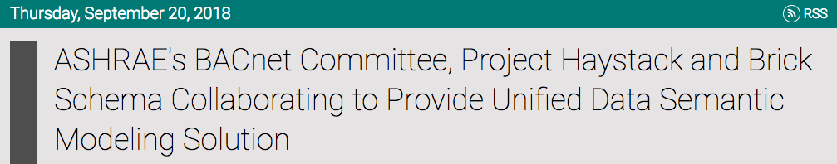

BACnet Collaboration with Haystack
Formal collaboration to integrate Haystack tagging and Brick data modeling concepts into the proposed ASHRAE Standard 223P for semantic tagging of building data.
ASHRAE Standard 223P: "Designation and Classification of Semantic Tags for Building Data” provides a dictionary of semantic tags for descriptive tagging of building data including building automation and control data along with associated systems.
By integrating Haystack tagging and Brick data modeling concepts with the upcoming ASHRAE Standard 223P, the result is intended to enable interoperability on semantic information across the building industry, particularly in building automation.
http://www.prweb.com/releases/2018/03/prweb15264563.htm

Slide 15
Haystack – Adoption and Support
Used in systems and software deployed in THOUSANDS of buildings to model 100’s of thousands of devices (last count – well over 30K facilities!)
Adoption by equipment manufacturers for next generation product – some on the market today
Intel joins Project Haystack as a Board Member (March 2017)
Dozens of systems integrators trained and using Haystack in projects every day
Over 1600 registered users on Project Haystack Forum
CABA White Paper March 2016

Slide 16
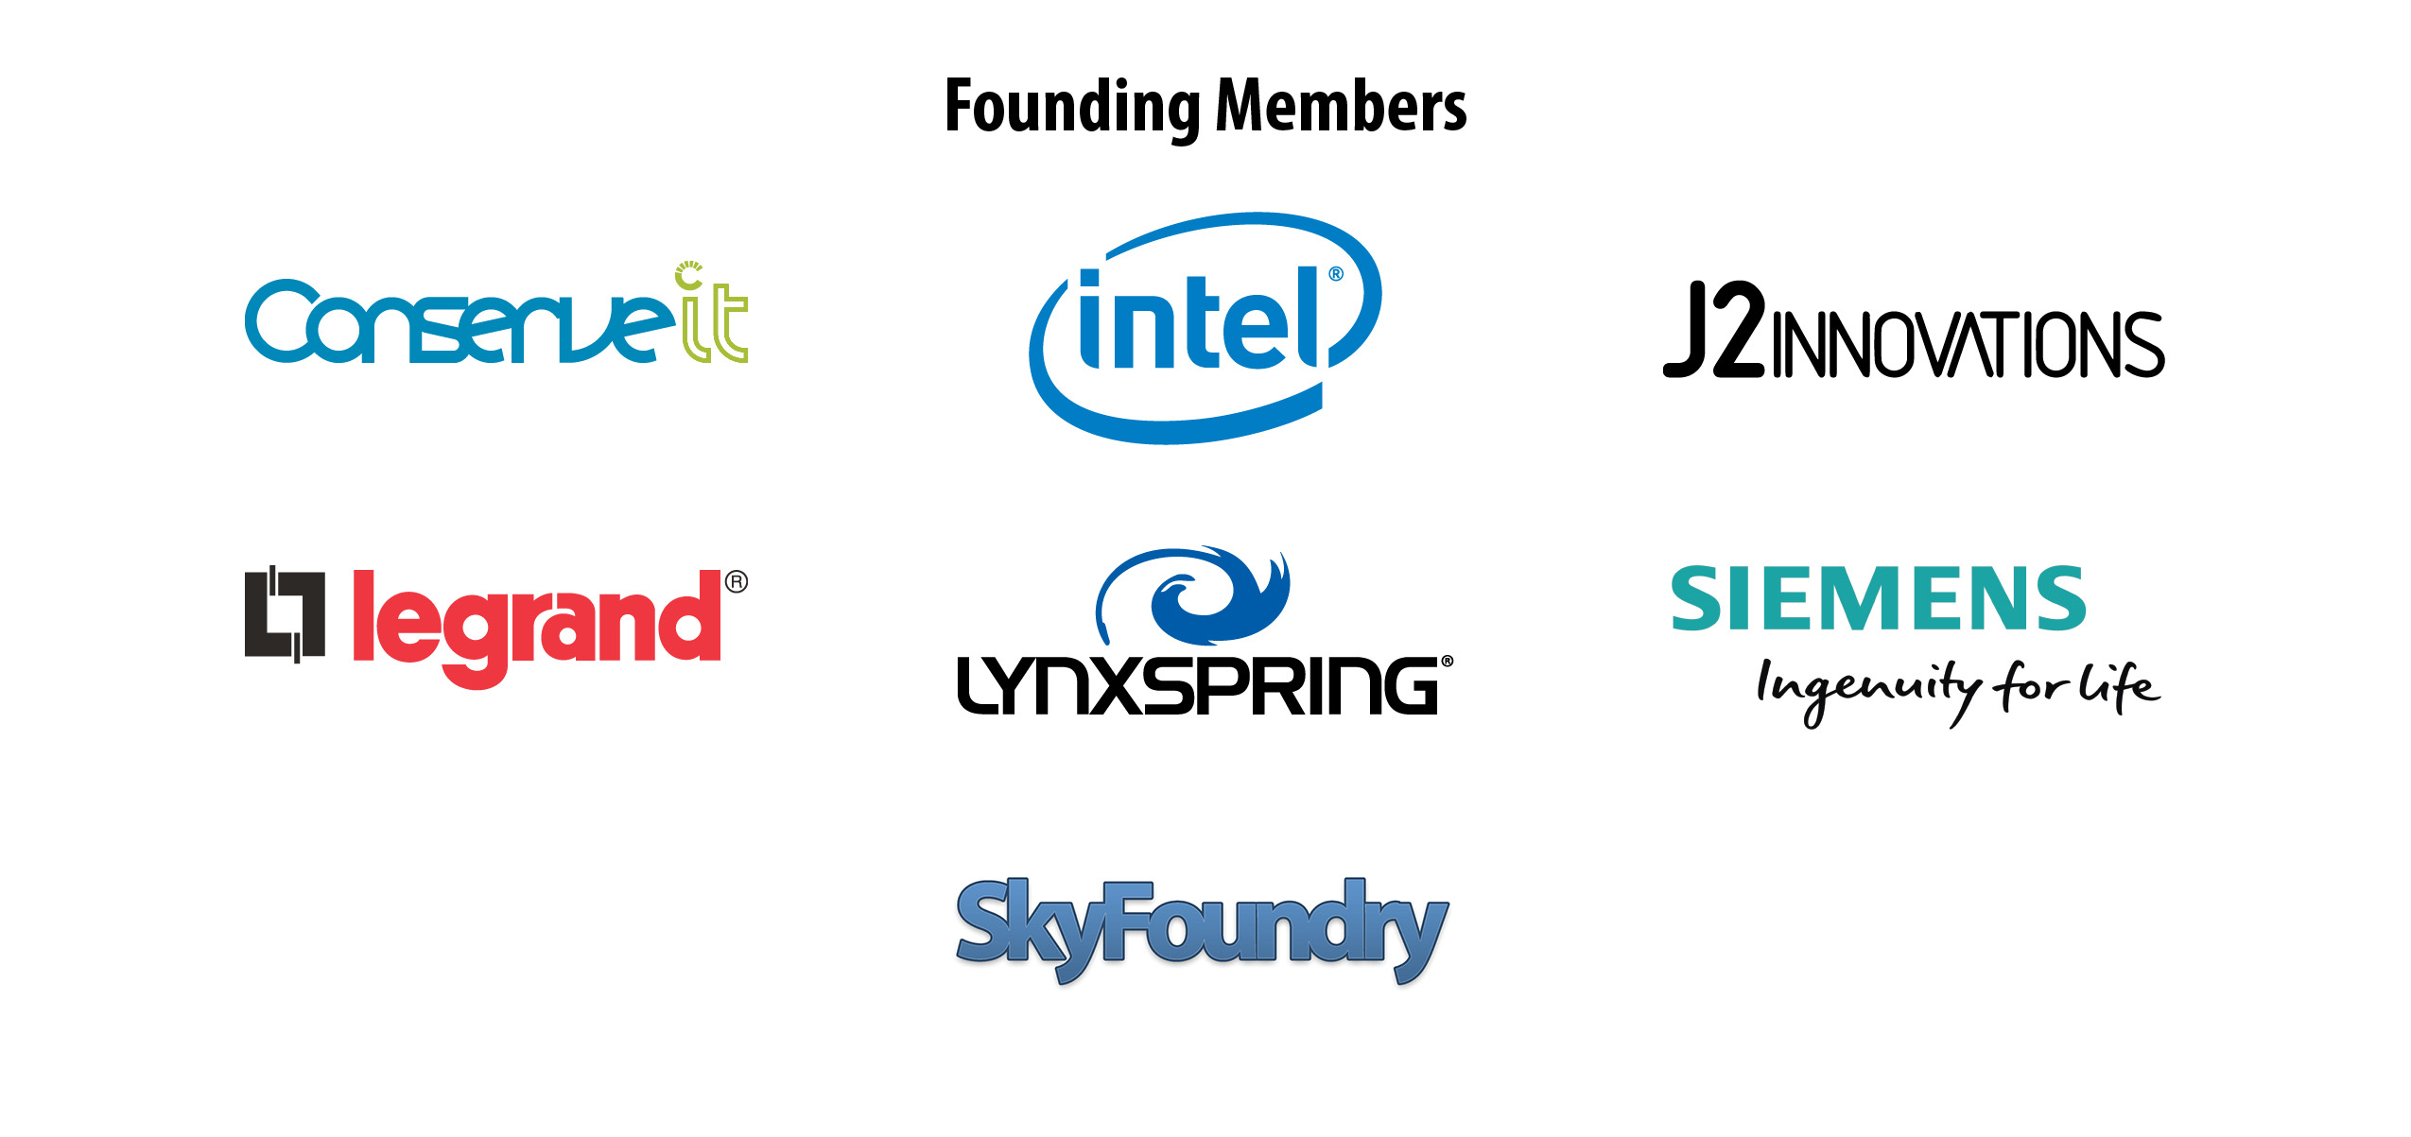

PROJECT Haystack – Our Members
May 13-15, 2019
16
May 2019

Slide 17

Haystack – Resources
Haystack Connections Magazine - Latest issue – Winter 2019:
https://marketing.project-haystack.org/images/connections-magazine/Project-Haystack-Connections-Magazine-Issue-5-Winter-2019.pdf
Guide Specifications:
https://marketing.project-haystack.org/project-haystack-resources/guide-specifications
CABA White Paper March 2016:
http://project-haystack.org/file/22/CABA-White-Paper-on-Project-Haystack.pdf
Detailed Reference Implementation:
https://project-haystack.org/file/28/Reference-Implementation--Applying-Haystack-Tagging-for-a-Sample-Building.pdf
Find Resources and Software downloads here:
https://marketing.project-haystack.org/
May 2019

Slide 18
Haystack –Key Takeaways
Deployed, working, proven in THOUSANDS of applications
Open source, community-driven, ZERO cost to access documentation and use
Extensible beyond community agreed equipment models – you can use Haystack methodology with your own tags/descriptors outside of standard group work on models
Lightweight – can be implemented in the smallest devices, network level controllers, standard databases – all the way to text files, & Excel worksheets
Human readable and machine readable
Accessible/understandable by real users – technicians and engineers that do systems integration
The standard, libraries and tools continue to advance through the efforts of a worldwide open source community
May 2019

Slide 19
Thank You for Joining Us!
John Petze
Executive Director, Project Haystack Organization
www.project-haystack.org
johnp@haystackconnect.org

